Slide 1
Evaluation of ML algorithms
Madhuri Sawant

Slide 2
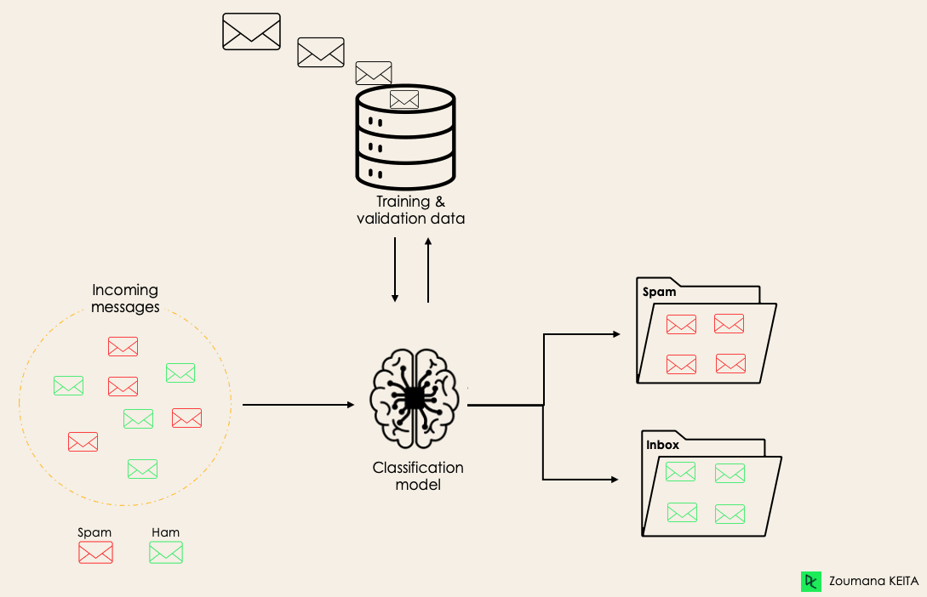
Classification is a supervised machine learning method where the model tries to predict the correct label of a given input data.
Source: https://www.datacamp.com/blog/classification-machine-learning

Slide 3
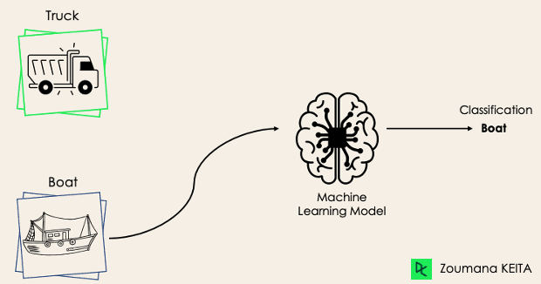
Binary Classification
Source: https://www.datacamp.com/blog/classification-machine-learning

Slide 4
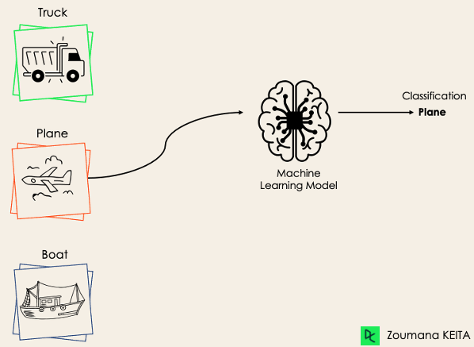
Multi-Class Classification
Source: https://www.datacamp.com/blog/classification-machine-learning

Slide 5
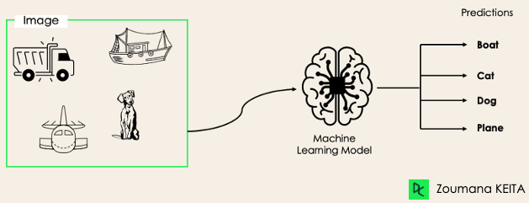
Multi-Label Classification
Source: https://www.datacamp.com/blog/classification-machine-learning

Slide 6
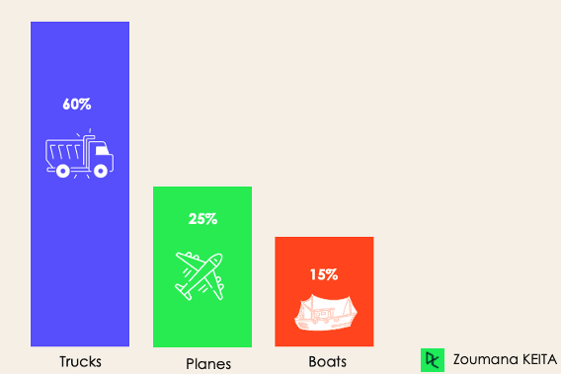
Imbalanced Classification
Source: https://www.datacamp.com/blog/classification-machine-learning

Slide 7
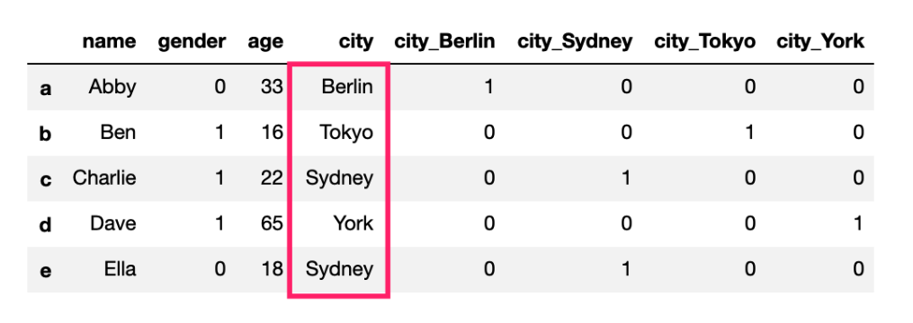
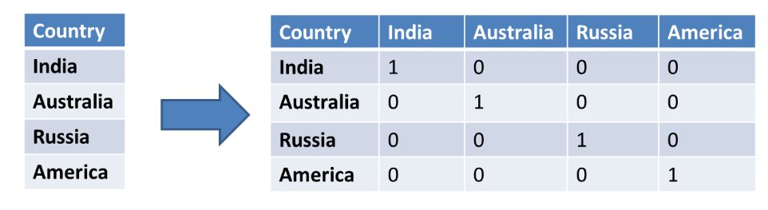
Source: https://fizzy.cc/label-encoding-one-hot-encoding/

Slide 8
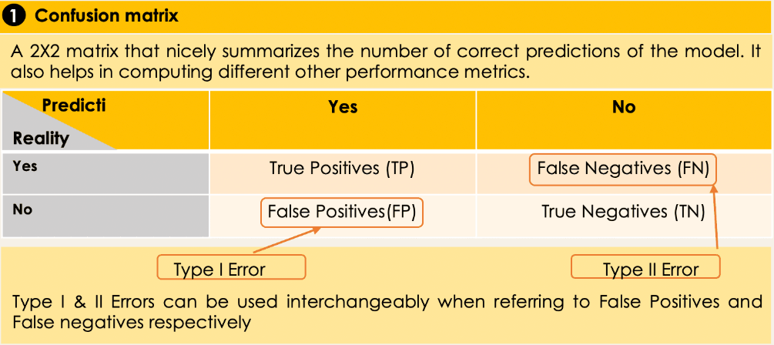
Metrics to evaluate classification algorithms
Source: https://www.datacamp.com/blog/classification-machine-learning

Slide 9
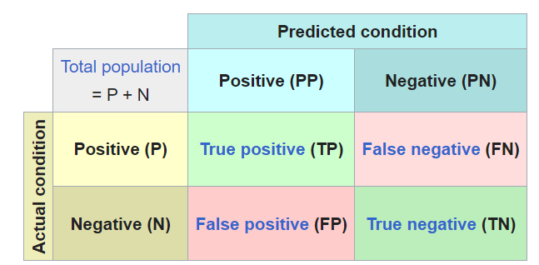
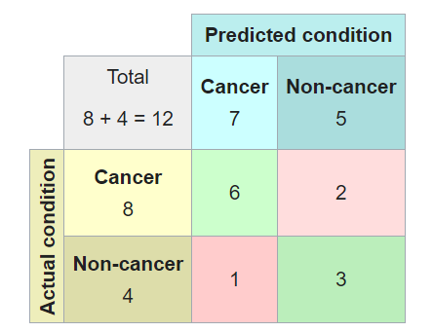
Confusion Matrix
Correct predictions are highlighted in green colour (diagonal)
Out of 8 samples with cancer, the system judged that 2 were cancer-free & 4 with cancer.
Source: Wikipedia

Slide 10
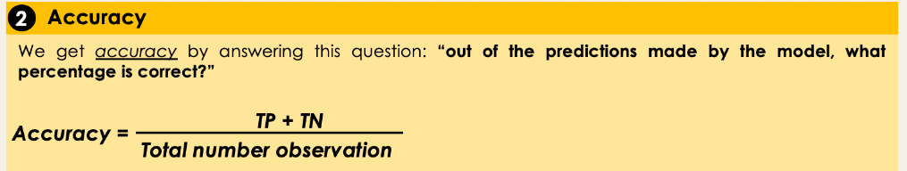
Metrics to evaluate classification algorithms
Source: https://www.datacamp.com/blog/classification-machine-learning

Slide 11
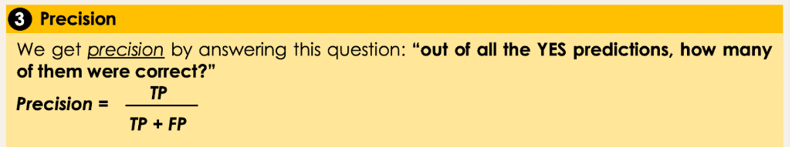
Metrics to evaluate classification algorithms
Source: https://www.datacamp.com/blog/classification-machine-learning

Slide 12
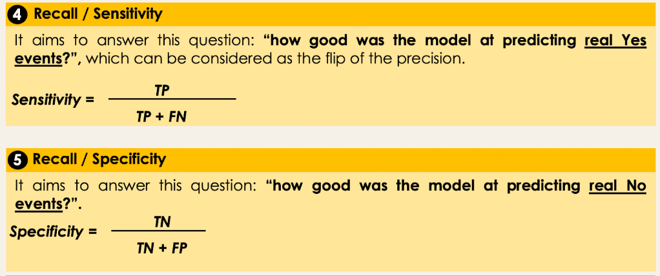
Metrics to evaluate classification algorithms
Source: https://www.datacamp.com/blog/classification-machine-learning

Slide 13
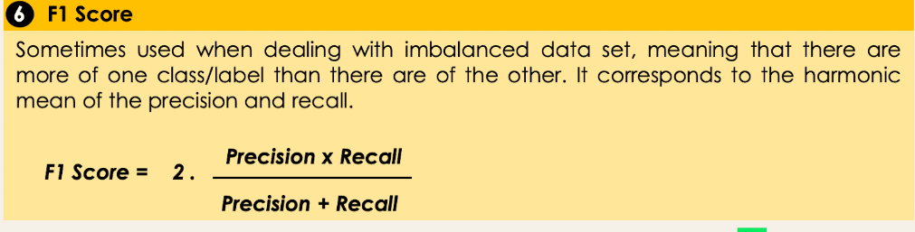
Metrics to evaluate classification algorithms
Source: https://www.datacamp.com/blog/classification-machine-learning

Slide 14
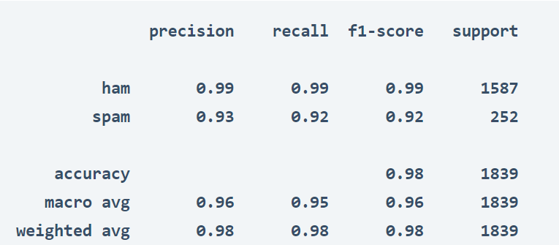
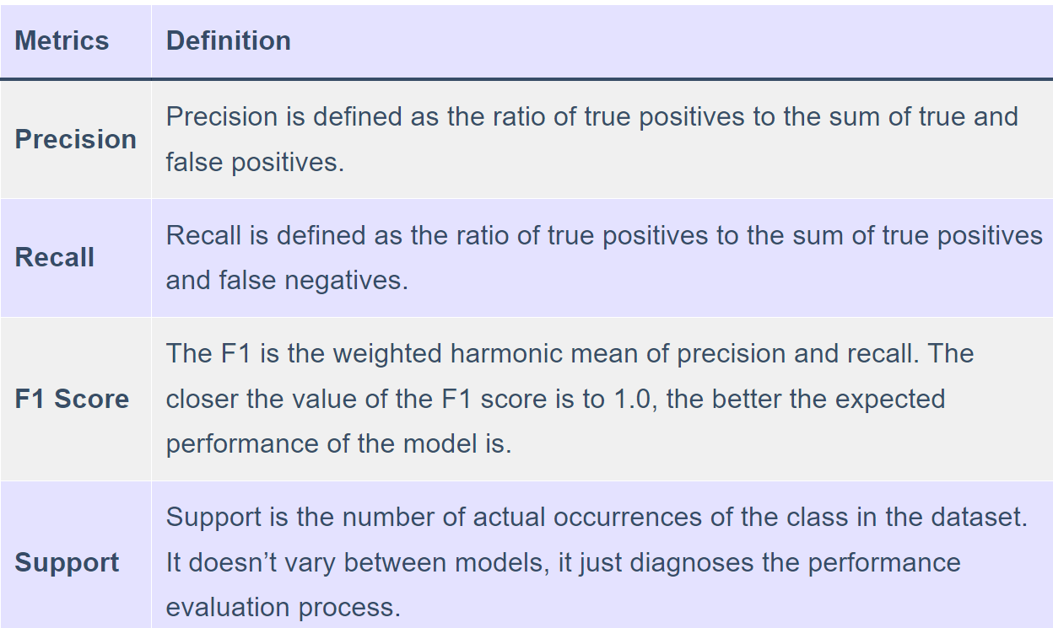
Classification Report
Source: https://thecleverprogrammer.com/2021/07/07/classification-report-in-machine-learning/

Slide 15
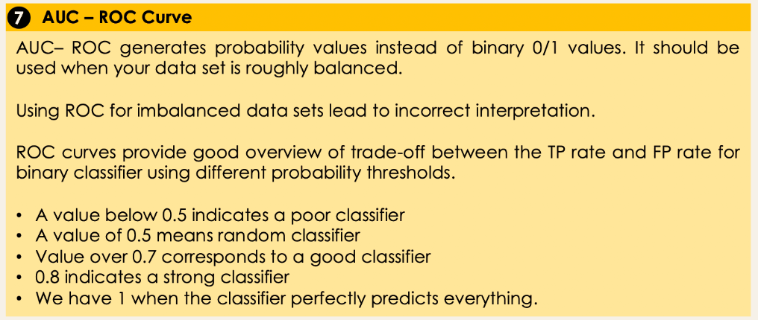
Metrics to evaluate classification algorithms
Source: https://www.datacamp.com/blog/classification-machine-learning

Slide 16
THANK YOU

